Slide 1
Concolic Testing: A modern software testing technique
Introduction Fundamental Ideas Survey of Related works
Dr. Durga Prasad Mohapatra
Professor
Department of CSE, NIT Rourkela
Concolic Testing: A modern software testing technique

Slide 2



Seminar Outline
Introduction Fundamental Ideas Survey of Related works
1 Introduction
2
Fundamental Ideas
3 Survey of Related works
Concolic Testing: A modern software testing technique

Slide 3
Introduction
Software Testing is an important phase in SDLC.
Helps to achieve software dependability and improve quality.
Time consuming: Approximately 40% of software development time is devoted to testing.
Testing can be done in two ways – Manual vs. Automated.
An automation tool for test case generation can effectively reduce the time required in testing.
Automation tool can be designed to generate test cases for different test coverage criteria.
Concolic Testing: A modern software testing technique

Slide 4
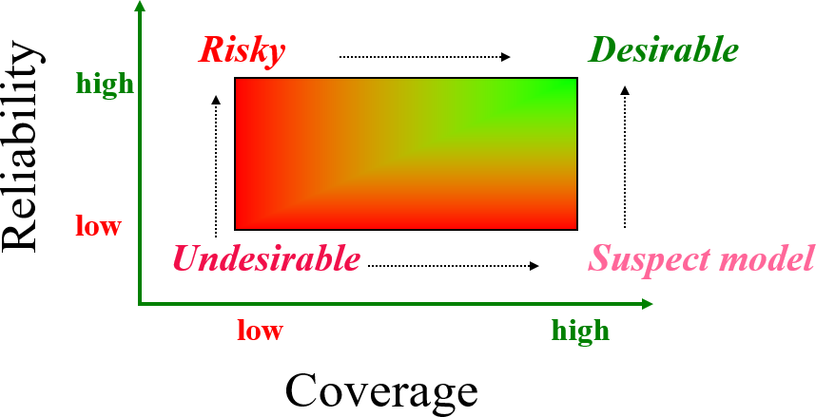
Reliability and Coverage Model -By Prof. Aditya Mathur
Introduction Fundamental Ideas Survey of Related works
Figure 1: Reliability and Coverage
Concolic Testing: A modern software testing technique

Slide 5
Software Testing
Introduction Fundamental Ideas Survey of Related works
“No product of human intellect comes out right the first time. We rewrite sentences, rip out knitting stitches, replant gardens, remodel houses, and repair bridges. Why should software be any different?”
- By Wiener, Ruth: Digital Woes, Why We Should Not Depend on Software.
Concolic Testing: A modern software testing technique

Slide 6
Software Testing
Introduction Fundamental Ideas Survey of Related works
The purpose of the verification process is to detect and report errors that have been introduced in the development process.
The verification process must ensure that the produced software implements intended function completely and correctly, while avoiding unintended function.
Verification is an integral process, which is coupled with every development step. Testing quality at the end of the life cycle is impractical.
Concolic Testing: A modern software testing technique

Slide 7
Software Testing: Coverage
Introduction Fundamental Ideas Survey of Related works
Coverage refers to the extent to which a given verification activity has satisfied its objectives: in essence, providing an exit criteria for when to stop. That is, what is “enough”is defined in terms of coverage.
Coverage is a measure, not a method or a test. As a measure, coverage is usually expressed as the percentage of an activity that is accomplished.
Our goal, then, should be to provide enough testing to ensure that the probability of failure due to hibernating bugs is low enough to accept. “Enough”implies judgment.
Concolic Testing: A modern software testing technique

Slide 8
RTCA/DO178-B/C standards
Introduction Fundamental Ideas Survey of Related works
RTCA stands for Radio Technical Commission for Aeronautics.
DO-178B (and DO-278) are used to assure safety of avionics software.
DO-178C includes the coverage analysis of Object-Oriented Programs used in safety of avionics software.
These documents provide guidance in the areas of SW development, configuration management, verification and the interface to approval authorities (e.g., FAA, EASA).
Concolic Testing: A modern software testing technique

Slide 9
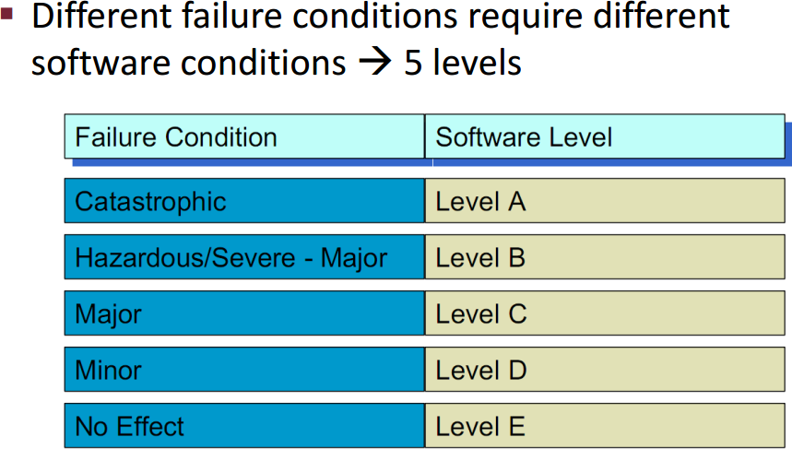
Levels of Software
Introduction Fundamental Ideas Survey of Related works
Figure 2: Levels of Software
Concolic Testing: A modern software testing technique

Slide 10
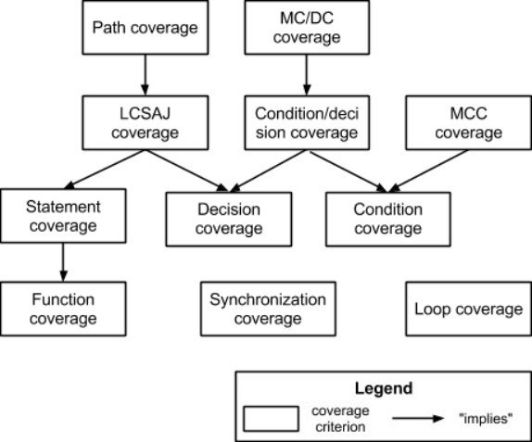
Relation of Coverages
Introduction Fundamental Ideas Survey of Related works
Figure 3: Relation of Coverages
Concolic Testing: A modern software testing technique

Slide 11
LCSAJ LCSAJ Coverage
LCSAJ stands for Linear Code Sequence and Jump.
It is a white box testing technique to identify the code coverage.
It begins at the start of the program or branch and ends at the end of the program or the branch.
LCSAJ is ordinarily equivalent to statement coverage.

Slide 12
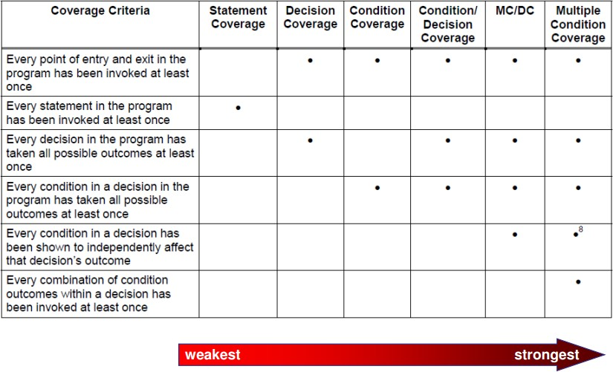
Types of Structural Coverage
Introduction Fundamental Ideas Survey of Related works
Figure 4: Types
Concolic Testing: A modern software testing technique

Slide 13
Introduction Fundamental Ideas Survey of Related works
Statement Coverage Branch Coverage Concolic Testing
Distributed Concolic Testing
Definitions
Predicate / Boolean Expression
A predicate is an expression that evaluates to a boolean value, and which is required for our approach.
A simple example is: ((a > b) ∨ C ) ∧ p(x ). Predicates may contain boolean variables, non-boolean variables that are compared with relational operators, and calls to function that return a boolean value, all three of which may be joined with logical operators.
12/35
Concolic Testing: A modern software testing technique

Slide 14
Introduction Fundamental Ideas Survey of Related works
Statement Coverage Branch Coverage Concolic Testing
Distributed Concolic Testing
Definitions
Predicate Coverage
For each p ∈ P, Test Requirement (TR) for predicate coverage contains two requirements: p evaluates to true, and p evaluates to false.
12/35
Concolic Testing: A modern software testing technique

Slide 15
Introduction Fundamental Ideas Survey of Related works
Statement Coverage Branch Coverage Concolic Testing
Distributed Concolic Testing
Definitions
Clause / Atomic Condition
A clause is a predicate that does not contain any of the logical operators.
The predicate ((a > b) ∨ C ) ∧ p(x ) contains three clauses; a relational expression (a > b), a boolean variable C and a boolean function call p(x).
12/35
Concolic Testing: A modern software testing technique

Slide 16
Introduction Fundamental Ideas Survey of Related works
Statement Coverage Branch Coverage Concolic Testing
Distributed Concolic Testing
Definitions
Clause Coverage
For each c ∈ C, TR for clause coverage contains two requirements: c evaluates to true, and c evaluates to false.
12/35
Concolic Testing: A modern software testing technique

Slide 17
Introduction Fundamental Ideas Survey of Related works
Statement Coverage Branch Coverage Concolic Testing
Distributed Concolic Testing
Definitions
Statement Coverage
The statement coverage based strategy aims to design the test cases so as to execute every statement in a program at least once.
The principle idea governing the statement coverage strategy is that a unless a statement is executed, there is no way to determine whether as error exists in that statement.
Concolic Testing: A modern software testing technique

Slide 18
Introduction Fundamental Ideas Survey of Related works
Statement Coverage Branch Coverage Concolic Testing
Distributed Concolic Testing
Definitions
Branch Coverage
Each decision should take all possible outcomes at least once either true or false.
For example if(m >n), the test cases are (1) m<=n, (2) m>n
Concolic Testing: A modern software testing technique

Slide 19
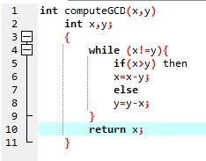
Introduction Fundamental Ideas Survey of Related works
Statement Coverage Branch Coverage Concolic Testing
Distributed Concolic Testing
Example
Figure 5: Euclid’s GCD computation program
Concolic Testing: A modern software testing technique

Slide 20
Introduction Fundamental Ideas Survey of Related works
Statement Coverage Branch Coverage Concolic Testing
Distributed Concolic Testing
Test cases for Statement Coverage
To design the test cases for the statement coverage, the conditional expression of the while statements needs to be made true and the conditional expression of the if statement needs to be made both true and false.
By choosing the test set {(x=3,y=3), (x=4,y=3),(x=3,y=4)}, all the statements of the program would be executed at-least once.
Concolic Testing: A modern software testing technique

Slide 21
Introduction Fundamental Ideas Survey of Related works
Statement Coverage Branch Coverage Concolic Testing
Distributed Concolic Testing
Test cases for Statement Coverage
For the GCD program, the test cases for branch coverage can be {(x=3,y=3), (x=3,y=2), (x=4,y=3),(x=3,y=4)}.
Concolic Testing: A modern software testing technique

Slide 22
Introduction Fundamental Ideas Survey of Related works
Statement Coverage Branch Coverage Concolic Testing
Distributed Concolic Testing
Observation
It is easy to show that branch coverage based testing is a stronger testing than statement coverage-based testing.
We can prove this by showing that branch coverage ensures statement coverage, but not vice-versa.
Concolic Testing: A modern software testing technique

Slide 23
Introduction Fundamental Ideas Survey of Related works
Statement Coverage Branch Coverage Concolic Testing
Distributed Concolic Testing
Definitions
Concolic Testing
The concept of CONCOLIC testing combines the CONCrete constraints execution and symBOLIC constraints execution to automatically generate test cases for full path coverage.
This testing generates test suites by executing the program with random values.
At execution time both concrete and symbolic values are saved for execution path.
During execution, the variables are stored in some symbolic values such as x0, and y0, instead of x and y.
The next iteration of the process forces the selection of different paths.
Concolic Testing: A modern software testing technique

Slide 24
Introduction Fundamental Ideas Survey of Related works
Statement Coverage Branch Coverage Concolic Testing
Distributed Concolic Testing
Definitions
Concolic Testing
The tester selects a value from the path constraints and negates the values to create a new path value. Then the tester finds concrete constraints to satisfy the new path values.
The selection of values is responsible by the Constraint Solver which is a part of Concolic tester.
These constraints are inputs for all next executions. This concolic testing is performed iteratively until exceeds the threshold value or sufficient code coverage is obtained.
Concolic Testing: A modern software testing technique

Slide 25
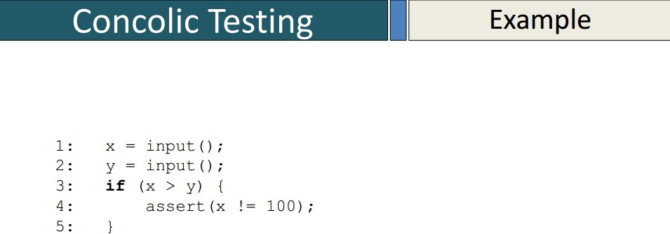
Introduction Fundamental Ideas Survey of Related works
Statement Coverage Branch Coverage Concolic Testing
Distributed Concolic Testing
Concolic Testing Example
21/35
Concolic Testing: A modern software testing technique

Slide 26
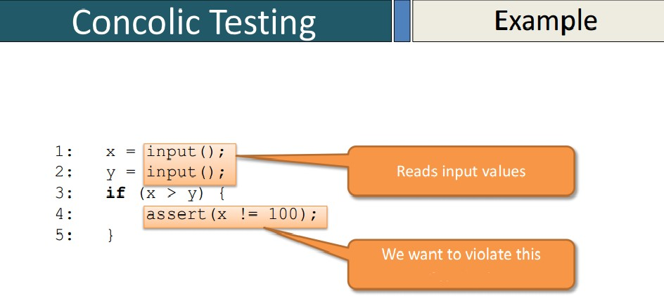
Introduction Fundamental Ideas Survey of Related works
Statement Coverage Branch Coverage Concolic Testing
Distributed Concolic Testing
Concolic Testing Example
21/35
Concolic Testing: A modern software testing technique

Slide 27
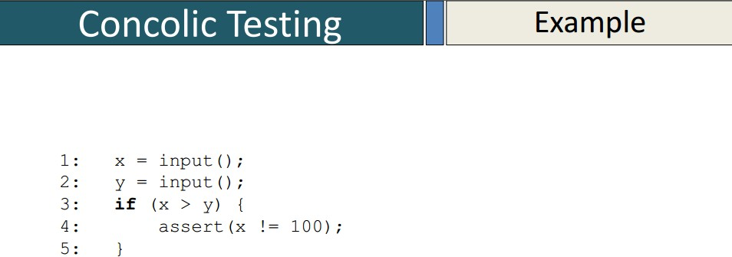
Introduction Fundamental Ideas Survey of Related works
Statement Coverage Branch Coverage Concolic Testing
Distributed Concolic Testing
Concolic Testing Example
21/35
Concolic Testing: A modern software testing technique

Slide 28
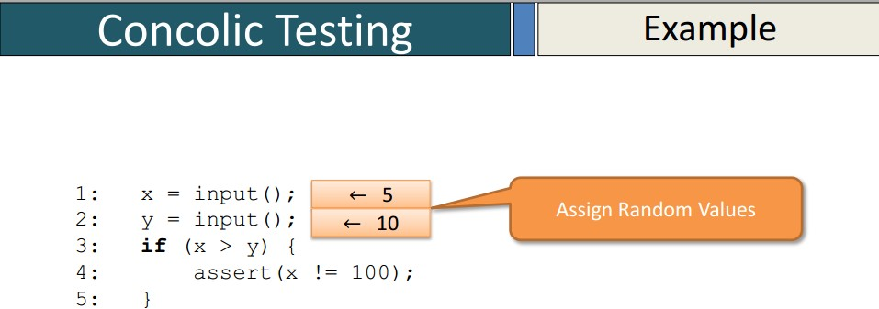
Introduction Fundamental Ideas Survey of Related works
Statement Coverage Branch Coverage Concolic Testing
Distributed Concolic Testing
Concolic Testing Example
21/35
Concolic Testing: A modern software testing technique

Slide 29
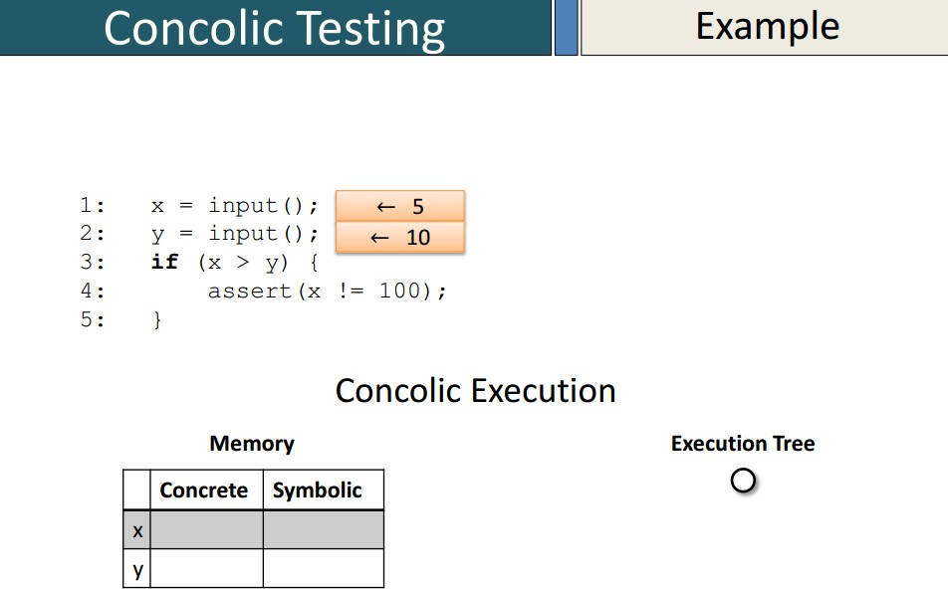
Introduction Fundamental Ideas Survey of Related works
Statement Coverage Branch Coverage Concolic Testing
Distributed Concolic Testing
Concolic Testing Example
21/35
Concolic Testing: A modern software testing technique

Slide 30
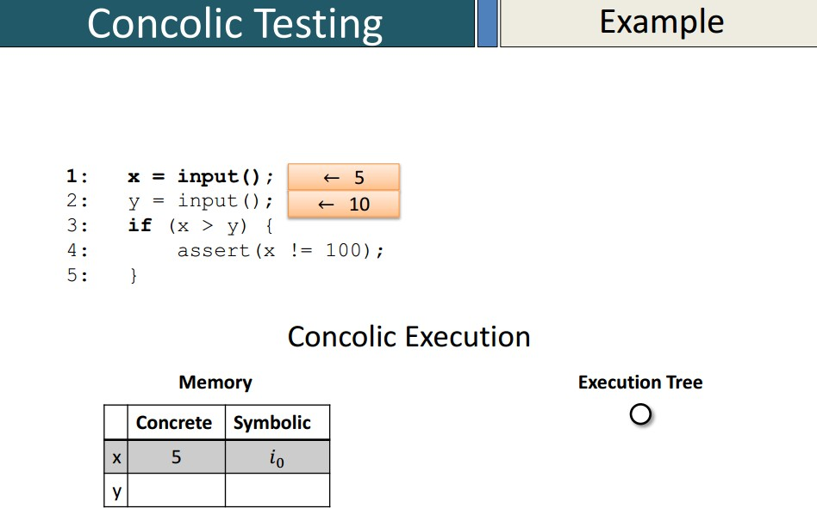
Introduction Fundamental Ideas Survey of Related works
Statement Coverage Branch Coverage Concolic Testing
Distributed Concolic Testing
Concolic Testing Example
21/35
Concolic Testing: A modern software testing technique

Slide 31
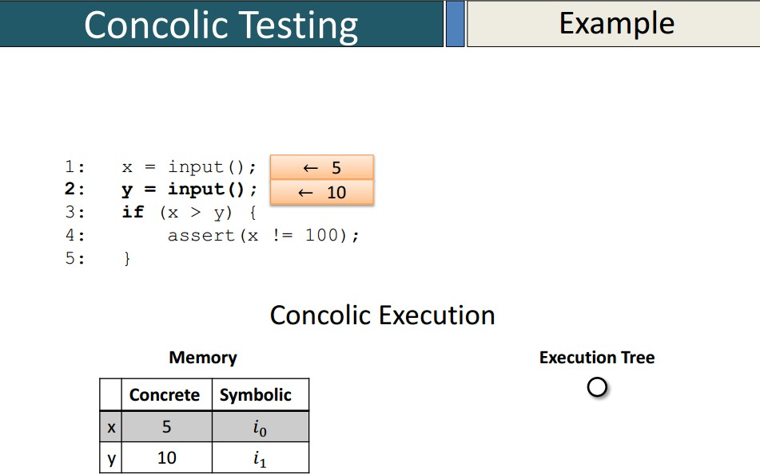
Introduction Fundamental Ideas Survey of Related works
Statement Coverage Branch Coverage Concolic Testing
Distributed Concolic Testing
Concolic Testing Example
21/35
Concolic Testing: A modern software testing technique

Slide 32
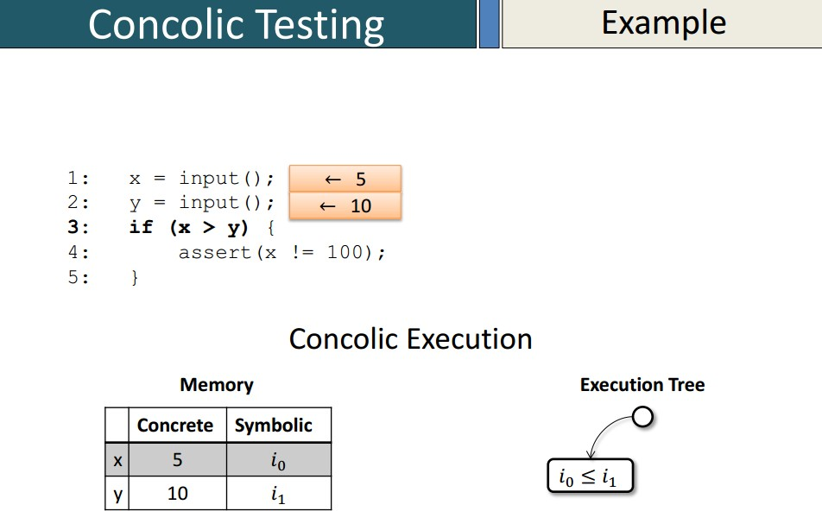
Introduction Fundamental Ideas Survey of Related works
Statement Coverage Branch Coverage Concolic Testing
Distributed Concolic Testing
Concolic Testing Example
21/35
Concolic Testing: A modern software testing technique

Slide 33
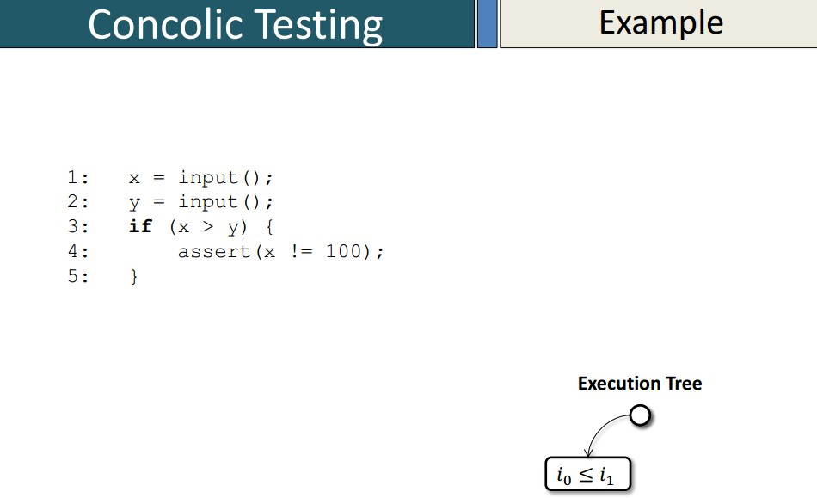
Introduction Fundamental Ideas Survey of Related works
Statement Coverage Branch Coverage Concolic Testing
Distributed Concolic Testing
Concolic Testing Example
21/35
Concolic Testing: A modern software testing technique

Slide 34
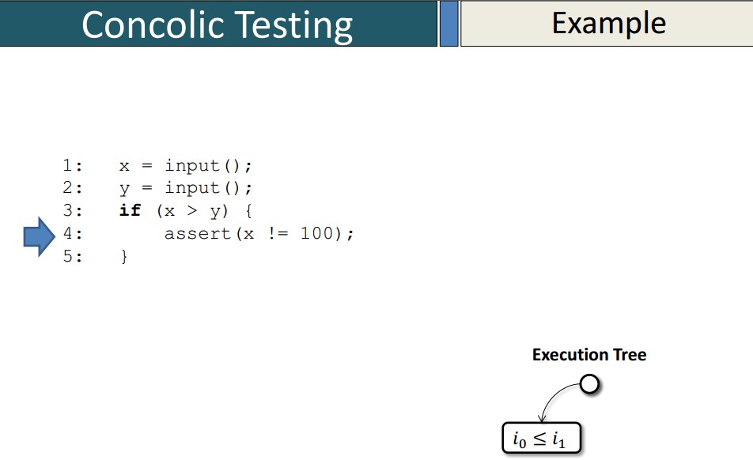
Introduction Fundamental Ideas Survey of Related works
Statement Coverage Branch Coverage Concolic Testing
Distributed Concolic Testing
Concolic Testing Example
21/35
Concolic Testing: A modern software testing technique

Slide 35
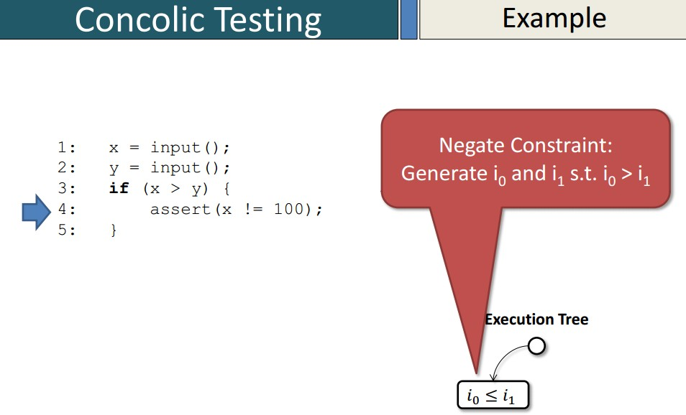
Introduction Fundamental Ideas Survey of Related works
Statement Coverage Branch Coverage Concolic Testing
Distributed Concolic Testing
Concolic Testing Example
21/35
Concolic Testing: A modern software testing technique

Slide 36
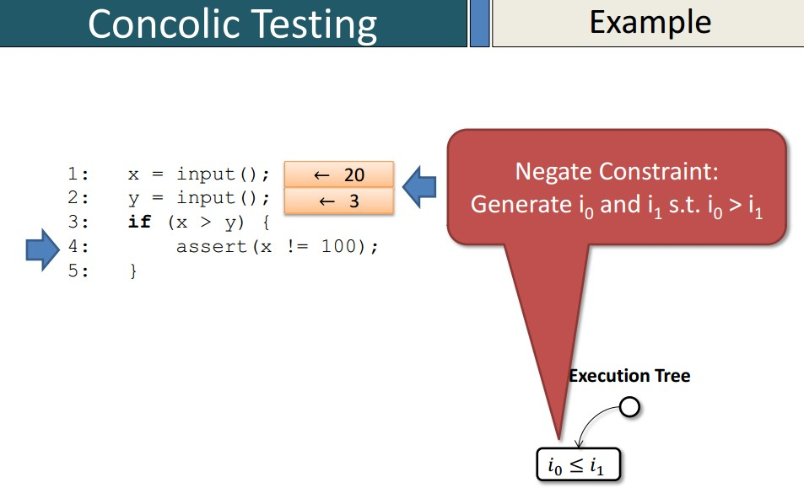
Introduction Fundamental Ideas Survey of Related works
Statement Coverage Branch Coverage Concolic Testing
Distributed Concolic Testing
Concolic Testing Example
21/35
Concolic Testing: A modern software testing technique

Slide 37

Introduction Fundamental Ideas Survey of Related works
Statement Coverage Branch Coverage Concolic Testing
Distributed Concolic Testing
Concolic Testing Example
21/35
Concolic Testing: A modern software testing technique

Slide 38

Introduction Fundamental Ideas Survey of Related works
Statement Coverage Branch Coverage Concolic Testing
Distributed Concolic Testing
Concolic Testing Example
21/35
Concolic Testing: A modern software testing technique

Slide 39

Introduction Fundamental Ideas Survey of Related works
Statement Coverage Branch Coverage Concolic Testing
Distributed Concolic Testing
Concolic Testing Example
21/35
Concolic Testing: A modern software testing technique

Slide 40
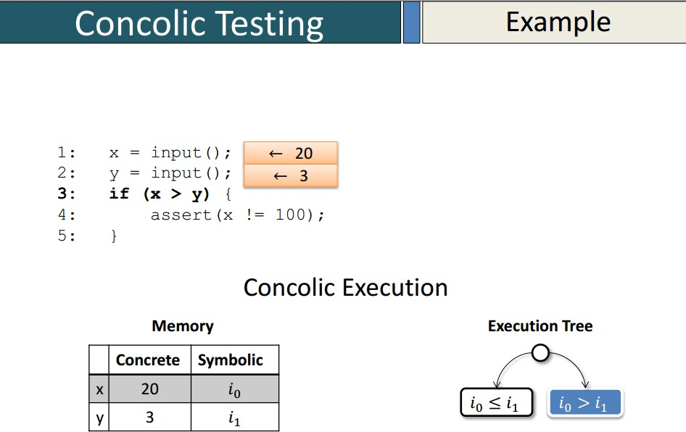
Introduction Fundamental Ideas Survey of Related works
Statement Coverage Branch Coverage Concolic Testing
Distributed Concolic Testing
Concolic Testing Example
21/35
Concolic Testing: A modern software testing technique

Slide 41
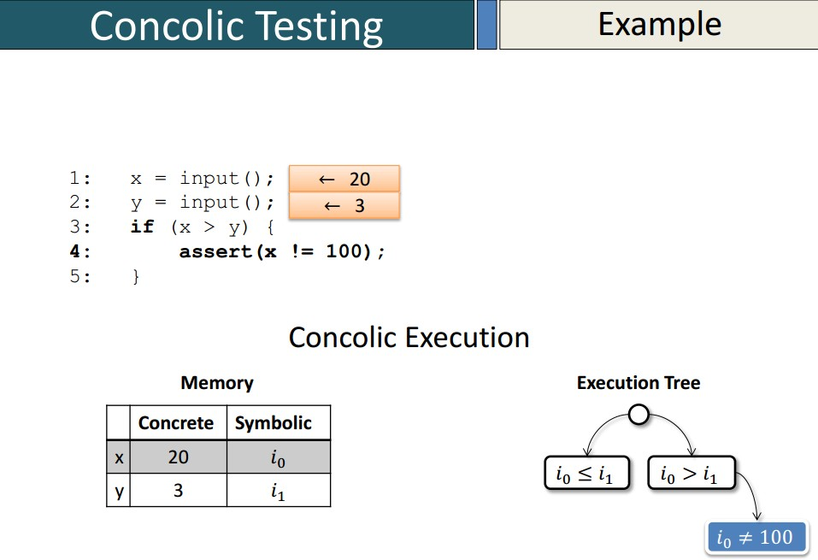
Introduction Fundamental Ideas Survey of Related works
Statement Coverage Branch Coverage Concolic Testing
Distributed Concolic Testing
Concolic Testing Example
21/35
Concolic Testing: A modern software testing technique

Slide 42
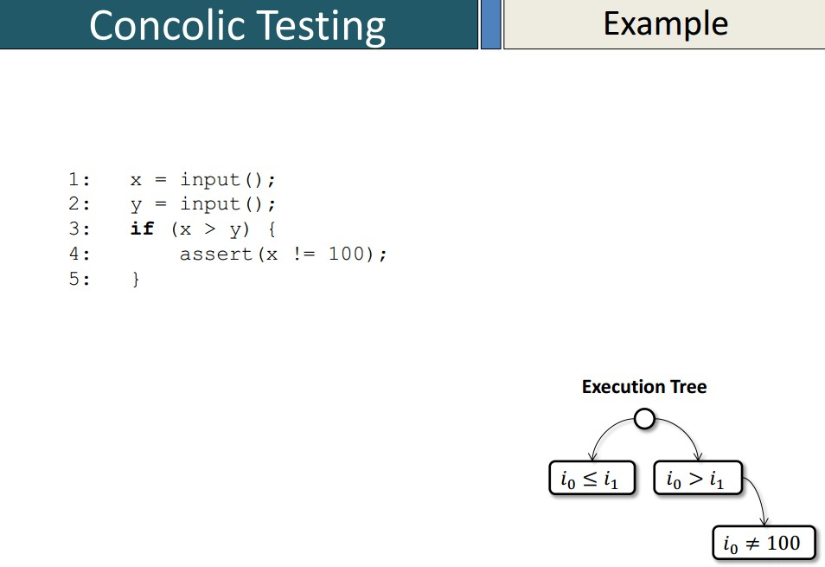
Introduction Fundamental Ideas Survey of Related works
Statement Coverage Branch Coverage Concolic Testing
Distributed Concolic Testing
Concolic Testing Example
21/35
Concolic Testing: A modern software testing technique

Slide 43
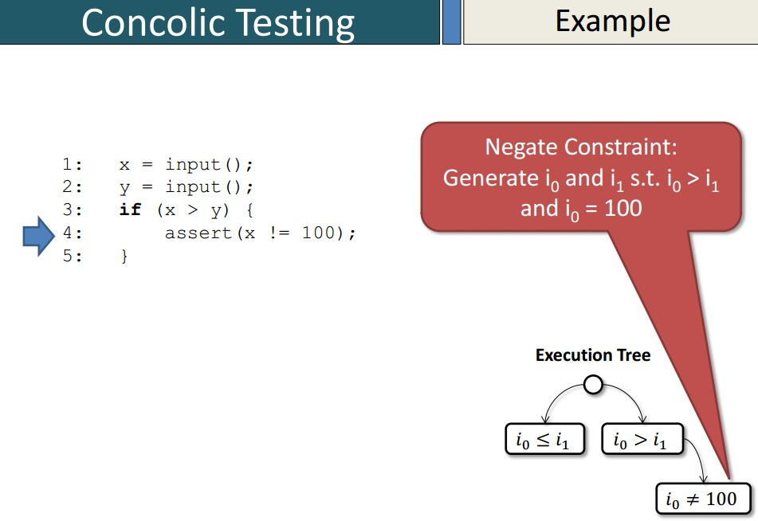
Introduction Fundamental Ideas Survey of Related works
Statement Coverage Branch Coverage Concolic Testing
Distributed Concolic Testing
Concolic Testing Example
21/35
Concolic Testing: A modern software testing technique

Slide 44
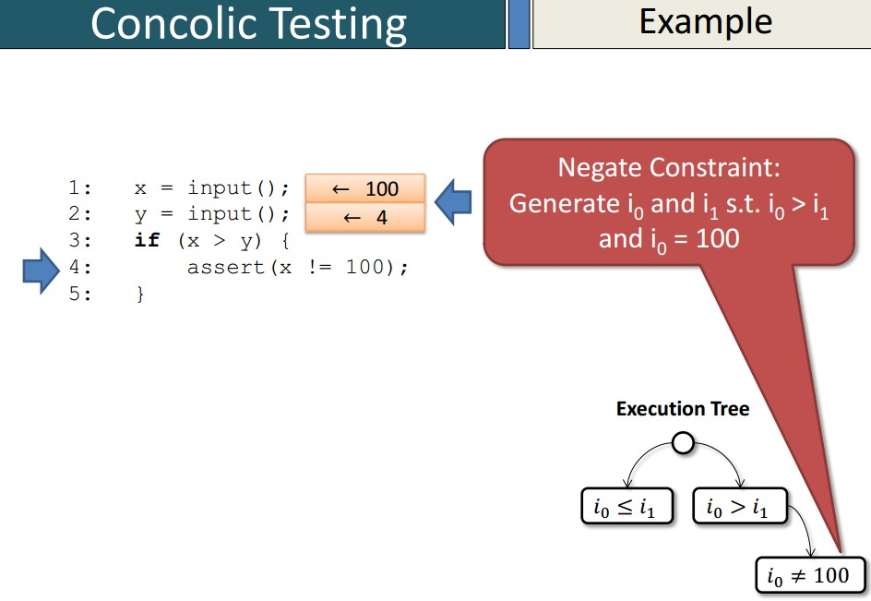
Introduction Fundamental Ideas Survey of Related works
Statement Coverage Branch Coverage Concolic Testing
Distributed Concolic Testing
Concolic Testing Example
21/35
Concolic Testing: A modern software testing technique

Slide 45
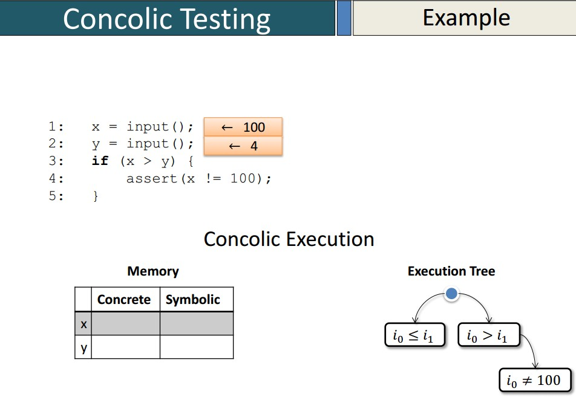
Introduction Fundamental Ideas Survey of Related works
Statement Coverage Branch Coverage Concolic Testing
Distributed Concolic Testing
Concolic Testing Example
21/35
Concolic Testing: A modern software testing technique

Slide 46
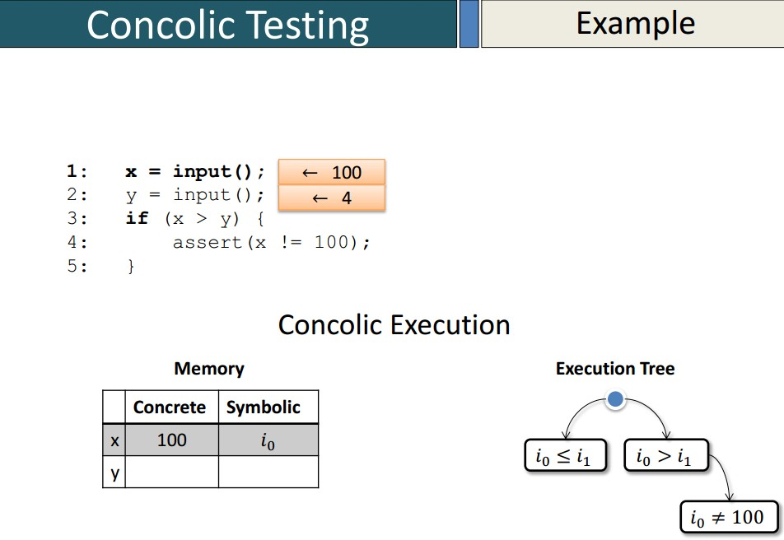
Introduction Fundamental Ideas Survey of Related works
Statement Coverage Branch Coverage Concolic Testing
Distributed Concolic Testing
Concolic Testing Example
21/35
Concolic Testing: A modern software testing technique

Slide 47
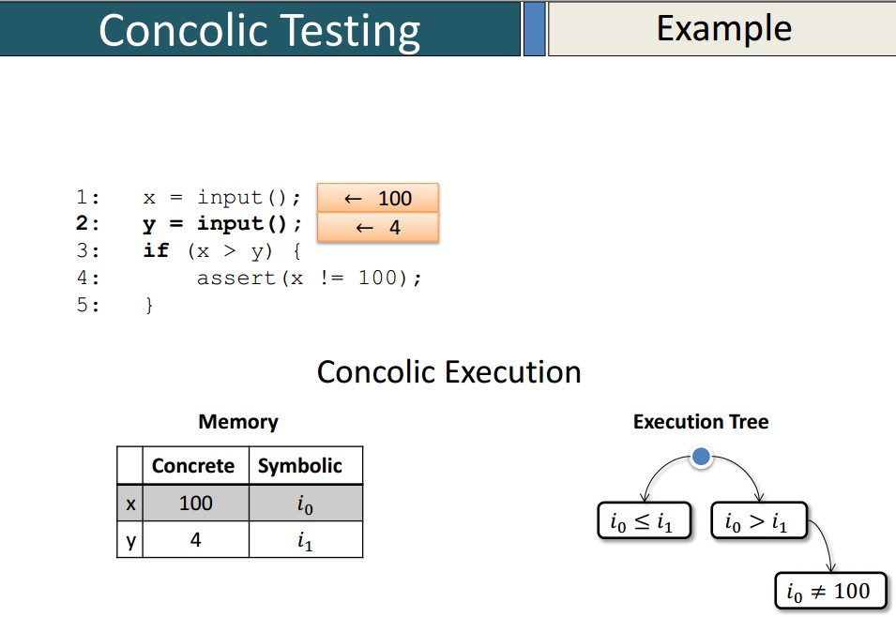
Introduction Fundamental Ideas Survey of Related works
Statement Coverage Branch Coverage Concolic Testing
Distributed Concolic Testing
Concolic Testing Example
21/35
Concolic Testing: A modern software testing technique

Slide 48
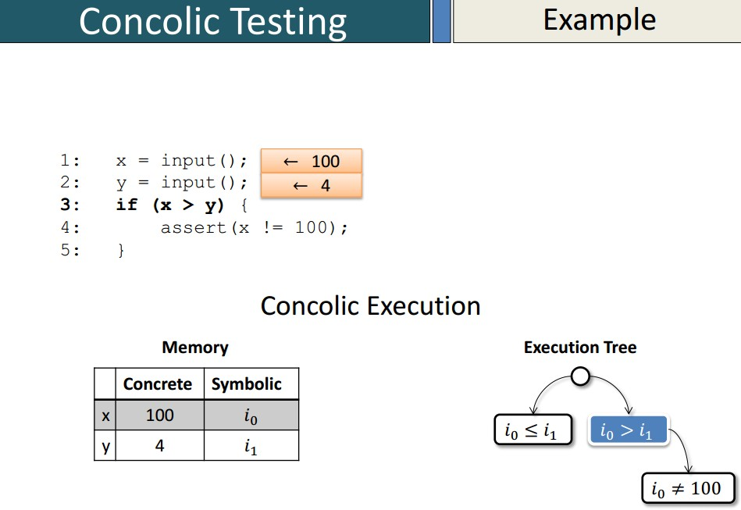
Introduction Fundamental Ideas Survey of Related works
Statement Coverage Branch Coverage Concolic Testing
Distributed Concolic Testing
Concolic Testing Example
21/35
Concolic Testing: A modern software testing technique

Slide 49
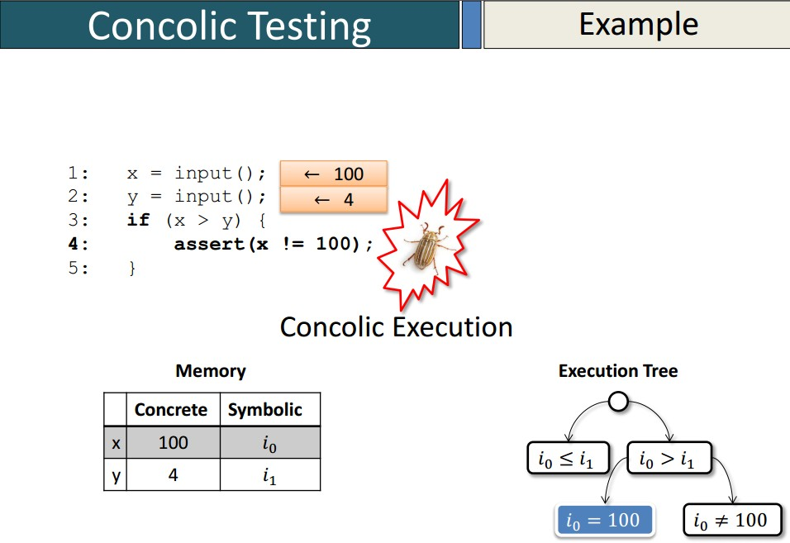
Introduction Fundamental Ideas Survey of Related works
Statement Coverage Branch Coverage Concolic Testing
Distributed Concolic Testing
Concolic Testing Example
21/35
Concolic Testing: A modern software testing technique

Slide 50
Introduction Fundamental Ideas Survey of Related works
Statement Coverage Branch Coverage Concolic Testing
Distributed Concolic Testing
Definitions
Concolic Testing: Final report
Concolic testing technique explored total 3 paths for the example program.
It has generated total three test cases for the variables x and y. These are shown in Table 1.
Table 1: Test cases
Test cases | TC1 | TC2 | TC3
x | 5 | 20 | 100
y | 10 | 3 | 4
Concolic Testing: A modern software testing technique

Slide 51
Introduction Fundamental Ideas Survey of Related works
Statement Coverage Branch Coverage Concolic Testing
Distributed Concolic Testing
Definitions
Distributed Concolic Testing
Distributed Concolic Testing (DCT) is an extension of the original concolic testing approach that uses several computing nodes in a distributed manner.
It significantly reduces the time to generate test cases with better efficiency.
Concolic testing is the combination of concrete and symbolic testing. In addition, distributed concolic testing is scalable and achieves a linear speedup by using a large number of computing nodes for test case generation.
Concolic Testing: A modern software testing technique

Slide 52
Introduction Fundamental Ideas Survey of Related works
Concolic Testers Comparison of related works
Characteristics of different approaches
Concolic Testers
In Table 1, we have compared concolic testing tools with respect to the following parameters/features: 1) variables types; 2) pointers; 3) native calls; 4) non-linear arithmetic operations; 5) bitwise operations; 6) array offsets and 7) function pointers.
The abbreviation used in Table 1 are the following: “Y ”means the tool supports the feature. “N”means the tool does not support the feature.
“P”means the tool can partially support the feature. “NA”means unknown.
Concolic Testing: A modern software testing technique

Slide 53
Introduction Fundamental Ideas Survey of Related works
Concolic Testers Comparison of related works
Characteristics of different approaches
Concolic Testers
Table 2: Summary of concolic tester with their properties.
Tool Name | Supporting Language | Supporting Platform | Support Constraints Solver | Support for float/double | Support for pointer | Support for native call | Support for non-linear arithmetic op. | Support for bitwise op. | Support for offset | Support for function pointer
DART | C | NA | LP SOLVER | N | N | N | NA | NA | N | N
SMART | C | LINUX | LP SOLVER | N | N | N | NA | NA | N | N
CUTE | C | LINUX | LP SOLVER | N | Y | N | NA | NA | N | N
jCUTE | JAVA | LINUX/WINDOWS | NA | N | - | N | NA | NA | N | N
CREST | C | LINUX | YICES | N | N | N | P | P | N | N
EXE | C | LINUX | STP | N | Y | N | Y | Y | Y | N
KLEE | C | LINUX | STP | N | Y | P | Y | Y | Y | NA
RWSET | C | LINUX | STP | N | Y | N | Y | Y | Y | NA
jFUZZ | JAVA | LINUX | BUILT ON JPF | N | NA | N | N | N | NA | NA
PATH CRAWLER | C | NA | NA | NA | NA | N | NA | NA | NA | NA
PEX | .NET | WINDOWS | Z3 | N | NA | N | NA | NA | NA | NA
SAGE | MACHINE CODE | WINDOWS | DISOLVER | NA | N | Y | NA | NA | NA | NA
APOLLO | PHP | WINDOWS | CHOCO | NA | NA | N | NA | N | NA | NA
SCORE | C | LINIX | Z3 SMT Solver | Y | N | N | Y | N | NA | NA
Concolic Testing: A modern software testing technique

Slide 54
Introduction Fundamental Ideas Survey of Related works
Concolic Testers Comparison of related works
Characteristics of different approaches
Comparison of related works
Table 3: Summary of different work on concolic testing.
S.No | Authors | Testing Type | FrameWork Type | Input Type | Output Type
1 | Das et al. [16] | Concolic Testing, MC/DC | BCT,CREST, CA | C-Program | MC/DC%
2 | Bokil et al. [24] | SC, DC, BC,MC/DC | AutoGen | C-Program | Test data, Time
3 | Kim et al. [20] | HCT | SMT Solver, CREST | Flash storage Platform Software | Reduction Ratio
4 | Majumdar et al. [17] | HCT, BC | CUTE | Editor in C-Language | Test Cases
5 | Burnim et al. [21] | Heuristics Concolic Testing, BC | CREST | Software Application in C | Branch Covered
6 | Kim et al. [23] | Concolic Testing | CREST | Embedded C Application | Branch Covered
7 | Kim et al. [22] | Concolic Testing | CONBOL | Embedded Software | BC%, Time
8 | Kim et al. [19, 25] | Distributed Concolic Testing | SCORE | Embedded C Program | BC%, Effectiveness
9 | Sen et al. [26] | Concolic Testing, BC | CUTE, JCUTE | C and Java Programs | Test Cases, BC%, Time
Concolic Testing: A modern software testing technique

Slide 55
Introduction Fundamental Ideas Survey of Related works
Concolic Testers Comparison of related works
Characteristics of different approaches
Characteristics of different approaches
Table 4: Characteristics of different approaches on concolic testing.
Sl.No | Authors | Generated Test Cases | Measuring Coverage% | Determined Time Constraints | Computed Speed
1 | Das et al. [16] | C | C | X | X
2 | Bokil et al. [24] | C | X | C | X
3 | Kim et al. [20] | C | X | X | X
4 | Majumdar et al. [17] | C | X | X | X
5 | Burnim et al. [21] | C | X | X | X
6 | Kim et al. [23] | C | X | X | X
7 | Kim et al. [22] | C | C | C | X
8 | Kim et al. [19, 25] | C | C | X | C
9 | Sen et al. [26] | C | C | C | X
Concolic Testing: A modern software testing technique

Slide 56
References ≫ I
Introduction Fundamental Ideas Survey of Related works
1
Palacios, M., Garc´ıa-Fanjul, J., Tuya, J. and Spanoudakis, G., 2015. Coverage-based testing for service level agreements. IEEE Transactions on Services Computing, 8(2), pages 299-313.
2
Fraser, G. and Arcuri, A., 2014. A large-scale evaluation of automated unit test generation using EvoSuite. ACM Transactions on Software Engineering and Methodology (TOSEM), 24(2), page 8.
3
Jones, JA. and Harrold, MJ. 2013. Test-suite reduction and prioritization for modified condition/decision coverage. IEEE Transactions on Software Engineering. 29(3), pages 195-209.
4
Baluda, M., Braione, P., Denaro, G. and Pezz`e, M., 2011. Enhancing structural software coverage by incrementally computing branch executability. Software Quality Journal, 19(4), pages 725-751.
Concolic Testing: A modern software testing technique

Slide 57
References ≫ II
Introduction Fundamental Ideas Survey of Related works
5
Jiang B, Tse TH, Grieskamp W, Kicillof N, Cao Y, Li X, Chan WK. 2011. Assuring the model evolution of protocol software specifications by regression testing process improvement. Software: Practice and Experience. 41(10). pages 1073-1103.
6 McMinn, P. 2004. Search-based software test data generation: a survey: Research articles. Software Testing, Verification and Reliability, 14(2), pages 105–156.
7
Harman M., Hu L., Hierons R., Wegener J., Sthamer H., Baresel A., and Roper M., 2004. Testability Transformation. IEEE TRANSACTIONS ON SOFTWARE ENGINEERING, 30(1), pages 1-14.
8
Wegener, J., Baresel, A. and Sthamer, H., 2001. Evolutionary test environment for automatic structural testing. Information and Software Technology, 43(14), pages 841-854.
9 Duran, J.W. and Ntafos, S.C., 1984. An evaluation of random testing. IEEE transactions on software engineering, (4), pages 438-444.
Concolic Testing: A modern software testing technique

Slide 58
References ≫ III
Introduction Fundamental Ideas Survey of Related works
10 Miller, W., and Spooner, DL. 1976. Automatic generation of floating-point test data. IEEE Transactions on Software Engineering, 2(3):223-226,
11 Kuhn, DR. 1999. Fault classes and error detection capability of specification-based testing. ACM Transactions on Software Engineering Methodology, 8(4), pages 411-424.
12 Ferguson, R. and Korel, B., 1996. The chaining approach for software test data generation. ACM Transactions on Software Engineering and Methodology (TOSEM), 5(1), pages. 63-86.
13 DeMillo, R., and Offutt, J., 1993. Experimental results from an Automatic Test Case Generation. ACM Transaction on Software Engineering Methodology, 2(2), pages 109-175.
14 Ntafos, S.C., 1988. A comparison of some structural testing strategies. IEEE Transactions on software engineering, 14(6), pages 868-874.
15 Chilenski, J., and Miller. S. 1994 Application of Modified Condition/Decision Coverage to Software Testing. Software Engineering Journal, pages 193-200.
Concolic Testing: A modern software testing technique

Slide 59
References ≫ IV
Introduction Fundamental Ideas Survey of Related works
16 Das A., and Mall R., 2013. Automatic Generation of MC/DC Test Data.
International Journal of Software Engineering, Acta Press 2(1).
17 Majumder R., and Sen K., 2007. Hybrid Concolic Testing. Proceedings of the 29th International Conference on Software Engineering,IEEE Computer Society,Washington, DC, USA pages 416-426.
18 Hayhurst, KJ., Veerhusen DS., Chilenski, JJ., Rierson, LK. 2001. A Practical Tutorial on Modified Condition/Decision Coverage, NASA/TM-2001-210876.
19 Kim Y., and Kim M., 2011. SCORE: a scalable concolic testing tool for reliable embedded software. Proceedings of the 19th ACM SIGSOFT symposium and the 13th European conference on Foundations of software engineering pages 420-423.
20 Kim, M., Kim, Y. and Choi, Y., 2012. Concolic testing of the multi-sector read operation for flash storage platform software. Formal Aspects of Computing, 24(3), pages 355-374.
Concolic Testing: A modern software testing technique

Slide 60
References ≫ V
Introduction Fundamental Ideas Survey of Related works
21 Burnim J., and Sen K., 2008. Heuristics for scalable dynamic test generation. In Proc. ASE, pages 443-446, Washington, D.C., USA.
22 Kim Y., Kim Y., Kim T., Lee G., Jang Y., and Kim M., 2013. Automated unit testing of large industrial embedded software using concolic testing. IEEE/ACM 28th International Conference on Automated Software Engineering (ASE) pages 519-528.
23 Kim M., and Kim Y.,and Jang Y., 2012. Industrial application of concolic testing on embedded software: Case studies. IEEE Fifth International Conference on Software Testing, Verification and Validation (ICST), pages 390-399.
24 Bokil, P., Darke, P., Shrotri, U., and Venkatesh, R., 2009. Automatic Test Data Generation for C Programs. In proceedings 3rd IEEE International Conference on Secure Software Integration and Reliability Improvement.
Concolic Testing: A modern software testing technique

Slide 61
References ≫ VI
Introduction Fundamental Ideas Survey of Related works
25 Kim M., Kim Y., and Rothermel G., 2012. A Scalable Distributed Concolic Testing Approach: An Empirical Evaluation. IEEE Fifth International Conference on Software Testing, Verification and Validation (ICST), pages 340-349.
26 Sen K., and Agha G., 2006. CUTE and jCUTE: Concolic Unit Testing and Explicit Path Model-Checking Tools (Tools Paper). DTIC Document.
Concolic Testing: A modern software testing technique

Slide 62
Introduction Fundamental Ideas Survey of Related works
Thank You!
Concolic Testing: A modern software testing technique

